Slide 1
DMPRoadmap
IDCC 2017

Slide 2
System Upgrade
Ruby 2.2.2
Rails 4.2.7
Upgraded all gem dependencies
Switched from CanCan to Pundit for authorization

Slide 3
Enhancements
Localisation
ORCID integration
Ability to set a plan’s visibility (public, private, etc.)
Now compatible with PostgreSQL
Unit tests

Slide 4
Optimizations
Removed unused tables, classes and methods
Addressed existing security issues
Removal of synchronous ajax calls
Removed DB calls from views
Significantly reduced the number of DB queries on page load

Slide 5
Data Model Refactor
Simplification of Template structures
Simplification of Plan structures
Addition of foreign keys and indexing
Cleanup of ActiveRecord associations

Slide 6
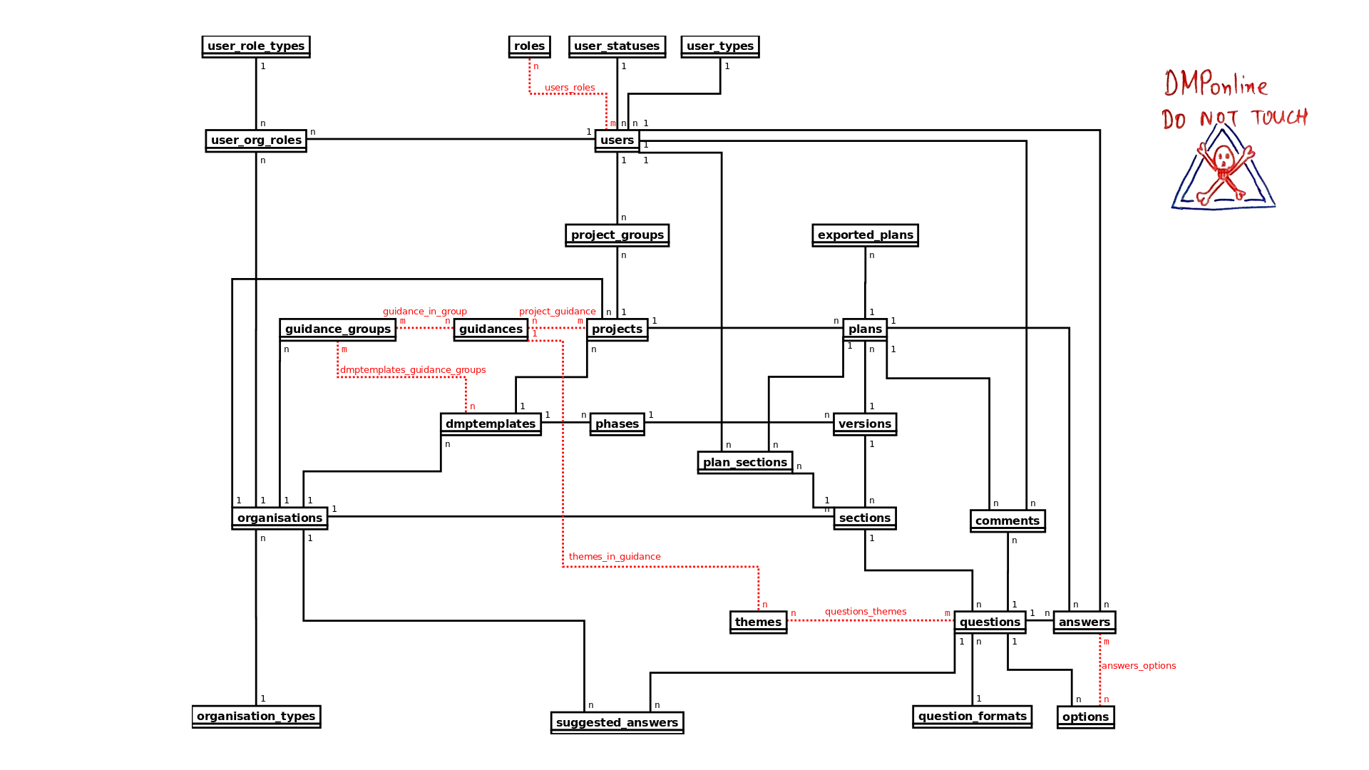
Data Model Refactor - From this:

Slide 7
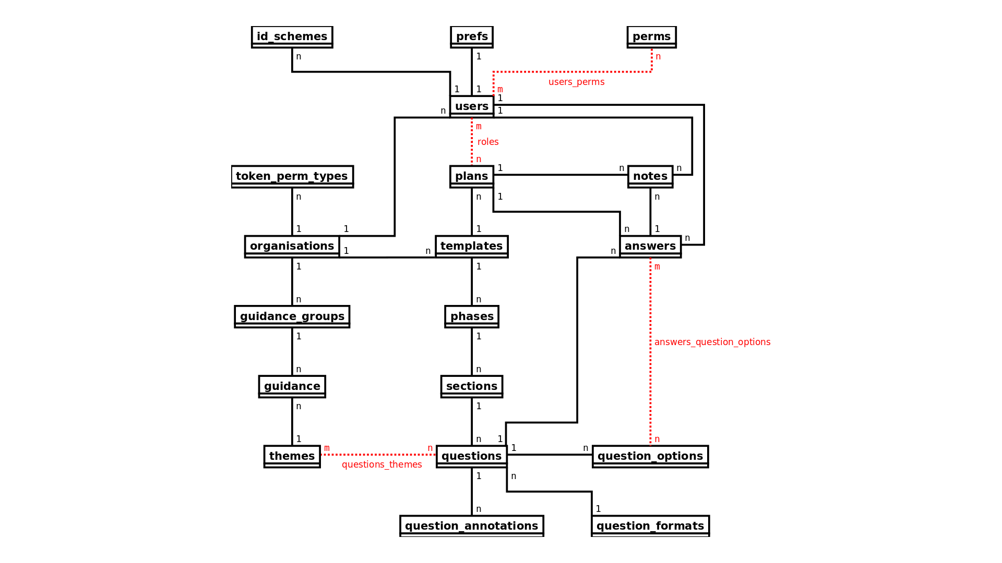
Data Model Refactor - To this:

Slide 8
Get Involved
Join us on Slack (email us to receive an invite)
Submit issues and feature requests on GitHub
Follow our blog: https://blog.dmptool.org/category/roadmap-project/feed/
brian.riley@ucop.edu jimmy.angelakos@ed.ac.uk

